Slide 1
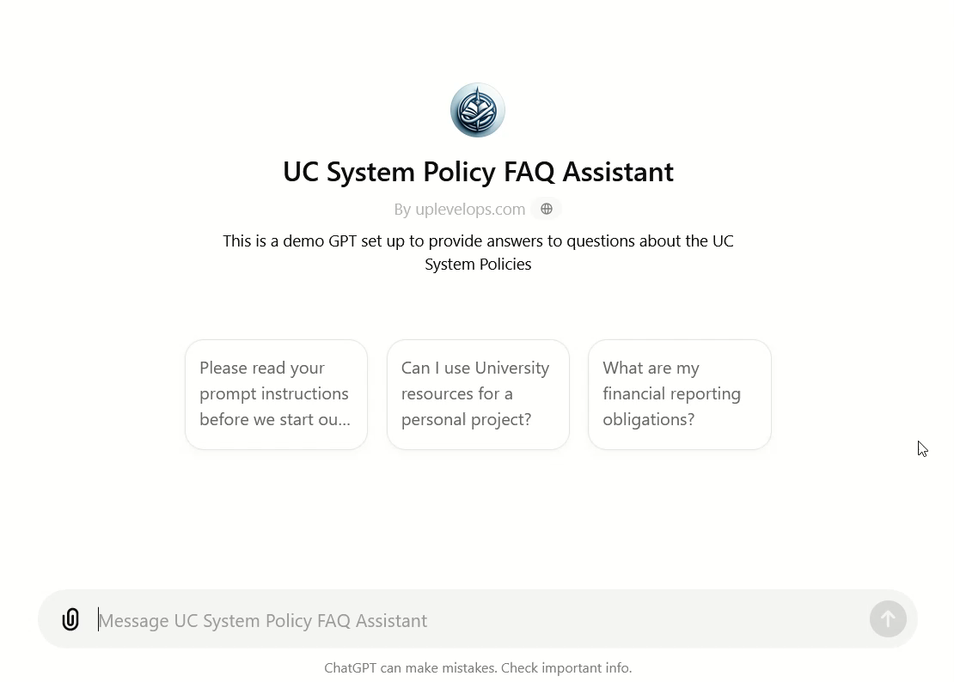
Custom GPT
FAQ Assistant Demo

Slide 2
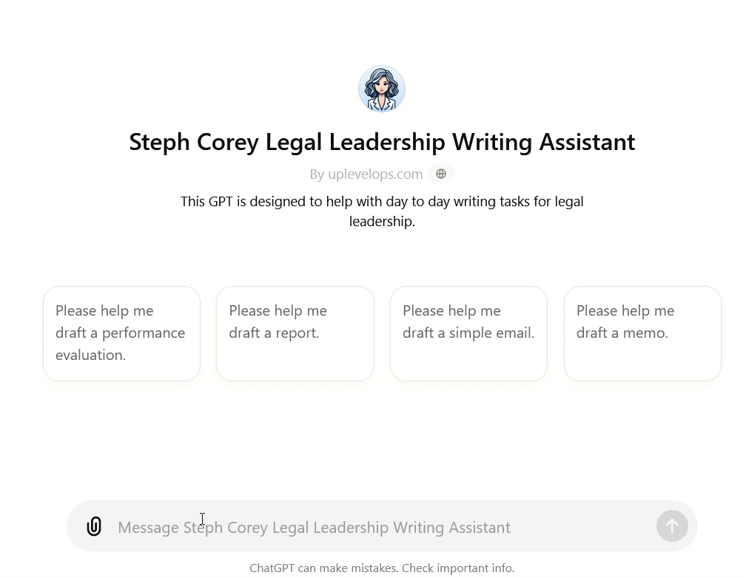
Custom GPT
Personalized
Writing
Assistant (Abbreviated Demo)

Slide 3
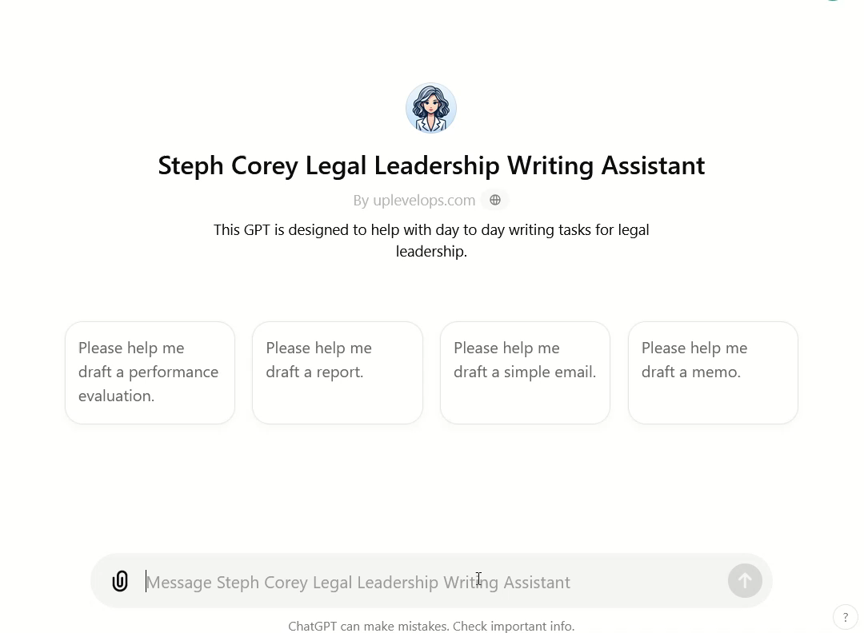
Custom GPT
Personalized
Writing
Assistant (Full Demo)

